Slide 1
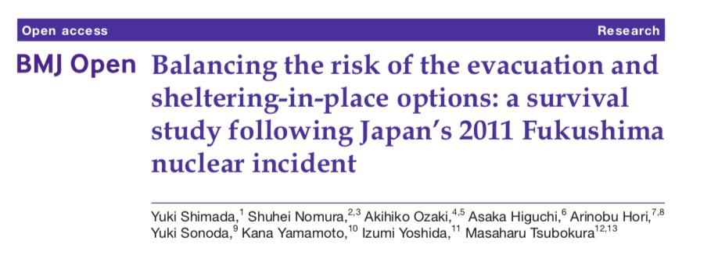
Balancing the risk of the evacuation and sheltering-in-place options: a survival study following Japan’s 2011 Fukushima nuclear incident
Miao Cai, Cheng-You Tsai,
Mausam Maru, Chaitali Dagli
12/13/2018

Slide 2
Introduction

Slide 3

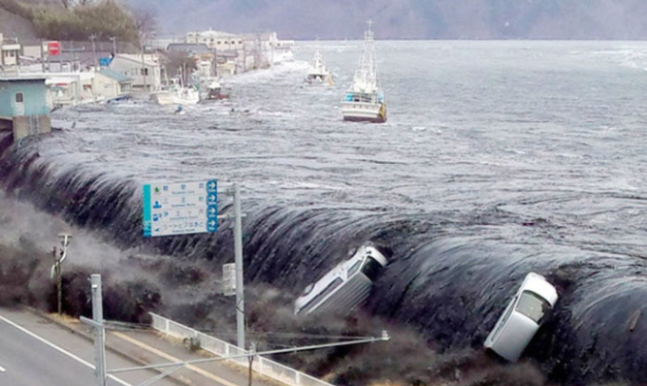
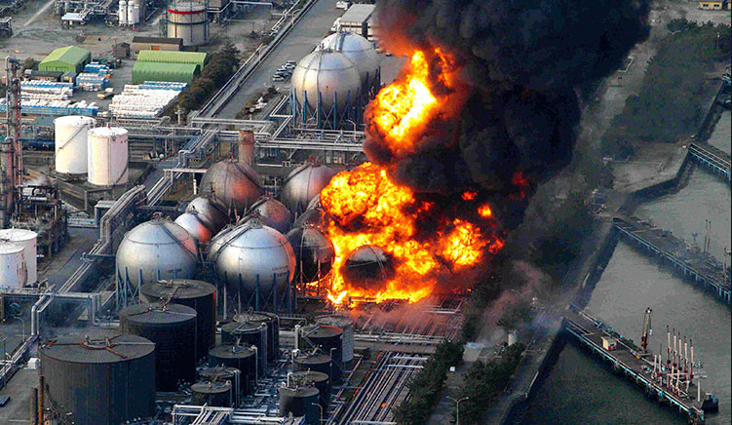
Fukushima Daiichi Nuclear Power Plant
The 9.1-magnitude (Mw) undersea megathrust earthquake occurred on 11 March 2011
Nuclear incident

Slide 4
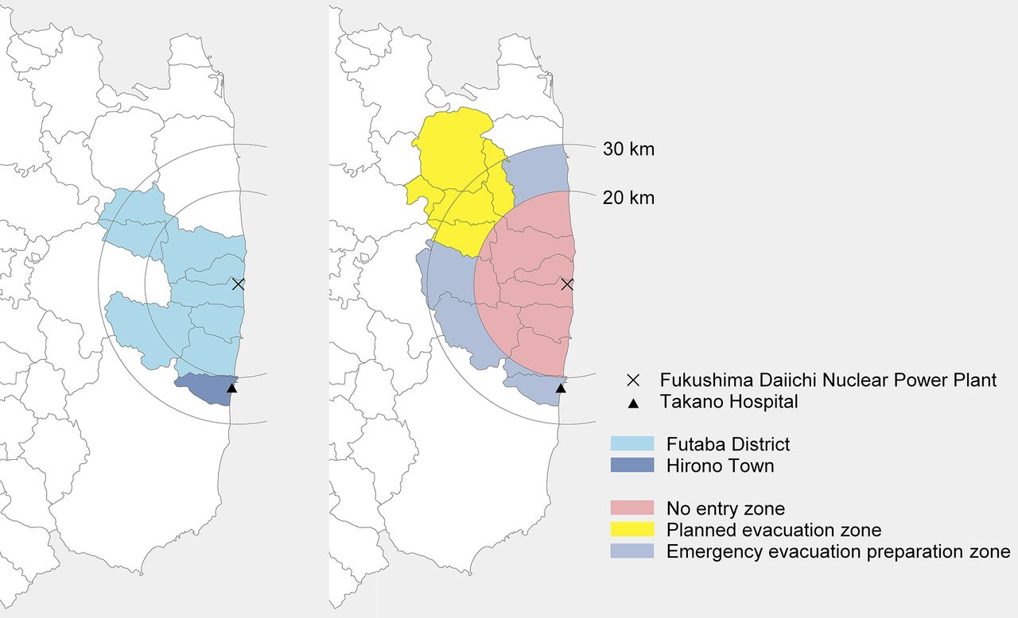
Notes:
Settings introduction

Slide 5
Aim of the study
To assess the mortality in hospital patients who sheltered-in-place following Japan’s 2011 Fukushima nuclear power plant incident.

Slide 6
Health Problem
Comparing hospital mortality in patients who are sheltered-in-place after the incident, with baseline pre-incident mortality and articulated post-incident circumstances while sheltering-in-place.
Planned and unplanned evacuation
Data from Takano Hospital (located 22 kms south of Fukushima Daiichi nuclear plant, Japan)
Notes:
2. Vulnerable population

Slide 7
Knowledge Gap
Safe sheltering-in-place.
Safe emergency response for vulnerable people.

Slide 8
Hypothesis
They did not hypothesize the effect of the nuclear incident in the study

Slide 9
Methods

Slide 10
Research design
Study: Retrospective study
Sample size: 484
Population : All patients admitted to Takano Hospital from 1 January 2008 to 31 December 2016
Patient population are not described.

Slide 11
Variables of interest
Dependent variables: time to death
Independent variables:
Post-incident (non-evacuees, evacuees, new admittees)
Covariates:
Sex, age at endpoint, primary disease, medical condition
All the relevant covariates are not included (cause of death).
Authors did not mention how they handled missing data.
Notes:
No interaction

Slide 12
Statistical Test
Start time: 1 January 2008
End time: 25 June 2017
Censoring is not mentioned.
Survival probability using the Kaplan-Meier product limit method
Bayesian multivariate Weibull regression.
No statistical assumption were tested.

Slide 13
Results

Slide 14
Study population
484 patients admitted between January 2008 and December 2016
Female 269 (55.6%) versus Male 215 (44.4%)
Internal: 356 (73.3%) and psychiatry: 128 (26.3%)
Percent of deaths: 261 (73.3%) in internal versus 32 (25.0%) in psychiatry
Experienced incident: 63 (58.3%) in internal versus 45 (41.7%) in psychiatry

Slide 15
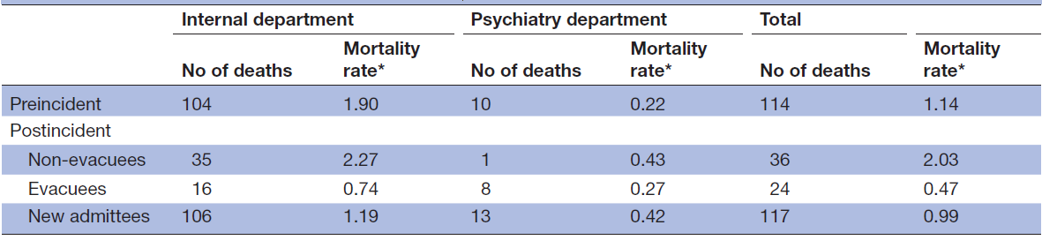
Death records

Slide 16
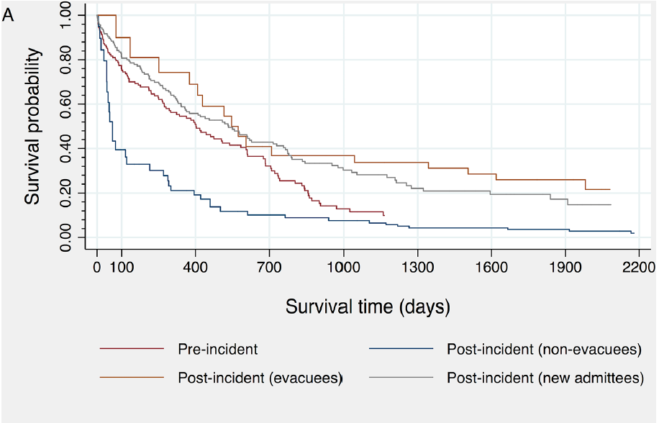
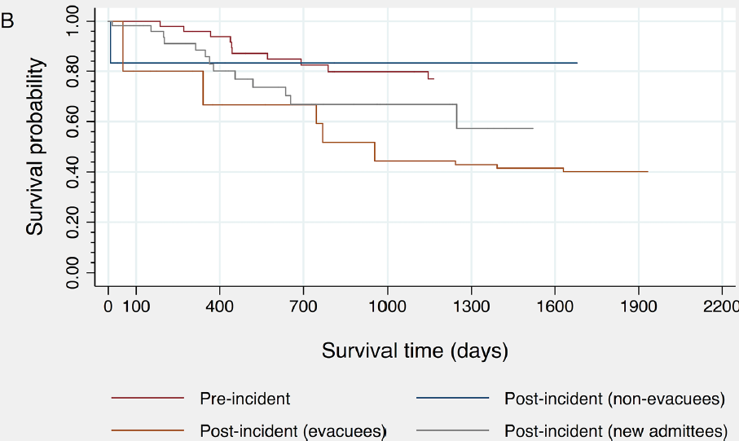
Kaplan-Meier Plots
Internal department
Psychiatry department
Pre
Non-evacuees
Pre
New admittees
evacuees
evacuees
Non-evacuees
New admittees

Slide 17
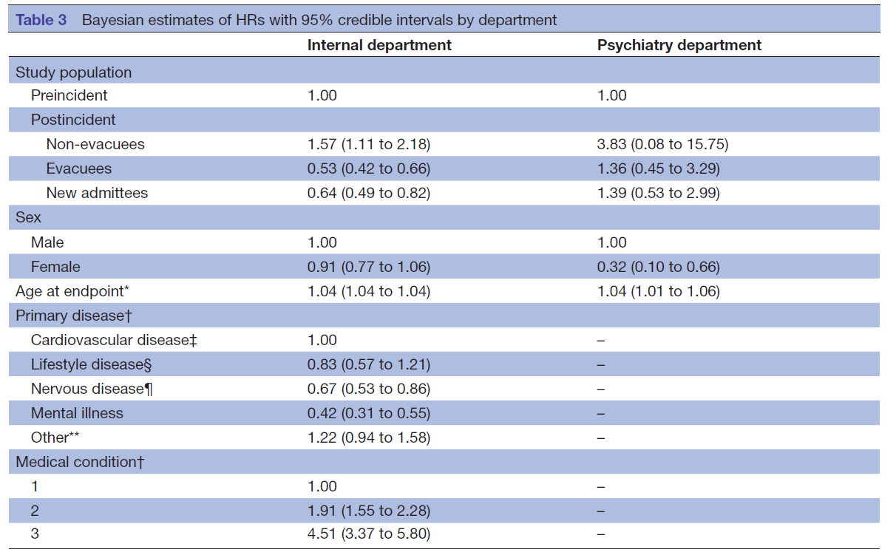
Hazard ratios and credible intervals reported.

Slide 18
Discussion

Slide 19
Conclusions
Age is an important factor that affects survival in disasters; younger patients are more likely to survive hazardous events than older ones
Survival time was entirely different between the internal and psychiatry department both pre-incident and post-incident

Slide 20
Strengths
This is the first study to assess the mortality in hospital patients who sheltered-in-place (non-evacuees)
This study also added new insights into the post-disaster mortality risk of psychiatric patients.
Bayesian analysis allows for intuitive interpretation of estimates

Slide 21
Limitations
The findings could not be applied to older psychiatric patients.
The results were not generalisable.
Able to obtain data only from one hospital (Takano hospital) instead of six other hospitals around the site.
While doing analysis, they did not consider patient’s medical conditions which could have changed overtime at the endpoint of the study.

Slide 22


Slide 23


